Slide 1



Concurrency in GO!
By Tanishq Saxena

Slide 2
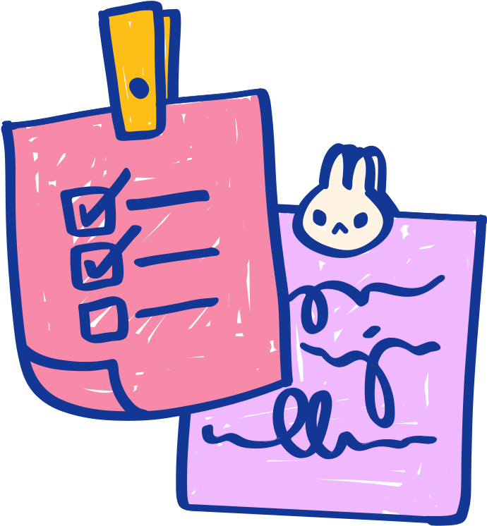
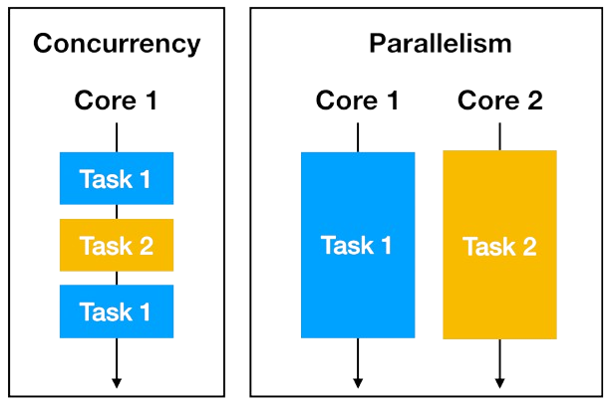


Now, what is Concurrency?
Suppose you’re watching reels while your boring chemistry lecture. You can’t focus on both reels and the lecture at the same time, so you’re switching between them efficiently. This is concurrency.
Concurrency v/s Parallelism
People often confuse between concurrency and parallelism. Assume that you are now watching reels while eating. So, you’re eating and watching at the exact same time. Both task are parallely running. This is called “parallelism”.

Slide 3




“
Concurrency in GO”lang”
”
Having problem in GO syntax? Wait I’ll explain

Slide 4
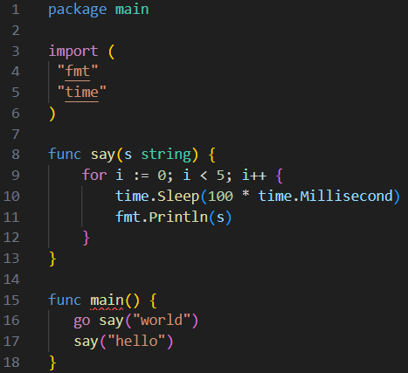
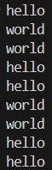


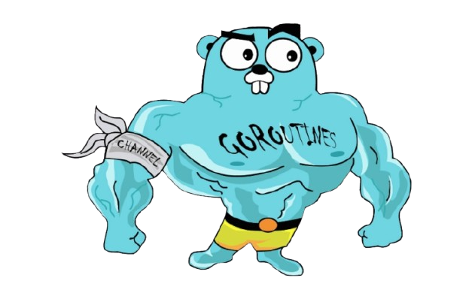
Goroutines
A goroutine is a lightweight thread managed by the Go runtime. Multiple Goroutines can run at the same time. You just add “go” keyword before a function to make it run as a Goroutine.
Both functions running together !
Note that we are using time.Sleep() here
What if we don’t use it?
Will the output be the same?
Let’s See
input
output

Slide 5

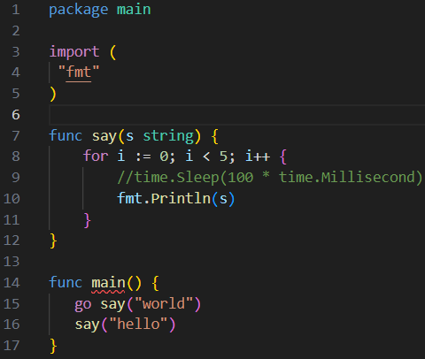
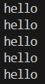



Without time.Sleep() ?
Wait? Where is “world” ?
output
So, what happened is that the say(“hello”) function was executed first and the code ended without even waiting for the say(“world”) function to do something. The main() function does not wait for the goroutine to finish
input
Solution? ⟶ “Waitgroups”

Slide 6


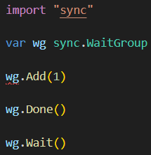

Waitgroups
A WaitGroup is used to wait for multiple goroutines to finish before moving on. Think of it like a counter that keeps track of how many goroutines are running, and when all are done, the program can continue. A WaitGroup helps pause execution until all goroutines are done.
How to use Waitgroups?
importing the required package
declaring the variable “wg” as the waitgroup
Adding something in the waitlist
(You can add more than 1 items in the list)
Remove the item from the waitlist after the execution is done
Tell the “main” function to wait for all the items in the waitlist

Slide 7

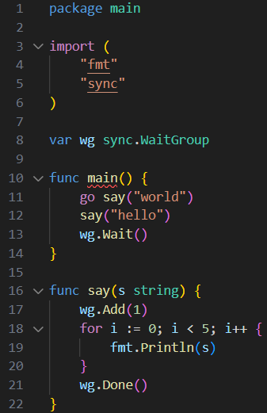
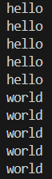



Implementing the code

Slide 8

Now you’ll be like:
So, let’s go!

Slide 9
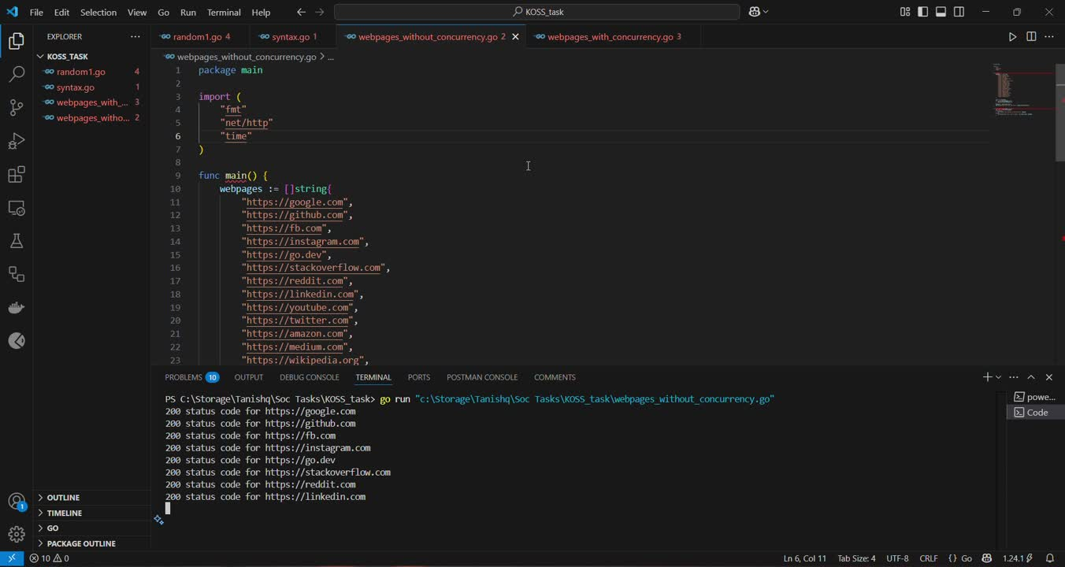
Practical use case
Now, let’s have a look at the real life use of concurrency in GO! Suppose we have a list of webpages and our backend server in GO wants to access them (Yes! GO is used for backend dev as well). Let us try doing that with and without using concurrency!

Slide 10


Results?
Without concurrency, the code took around 17 seconds to execute. But when we used concurrency, it took only 1.5 seconds ! So, concurrency is actually helpful in optimizing real life problems!
But,
SURPRISED?

Slide 11
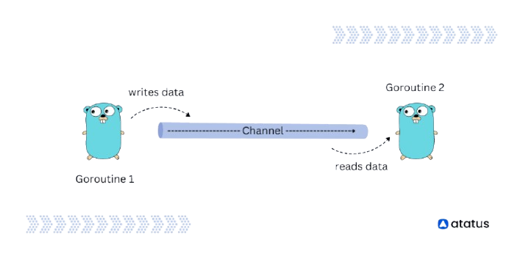

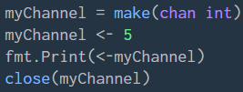
Channels
A channel is a way for goroutines to communicate safely. It helps send and receive data between goroutines. Think of it like a “pipe” where one goroutine puts data in, and another takes it out.
Syntax?
Initializing a channel which stores “int” value type, you may use any other type like strings, bool, float64, etc.
Sending something to the channel
Receiving data from the channel
Closing a channel

Slide 12


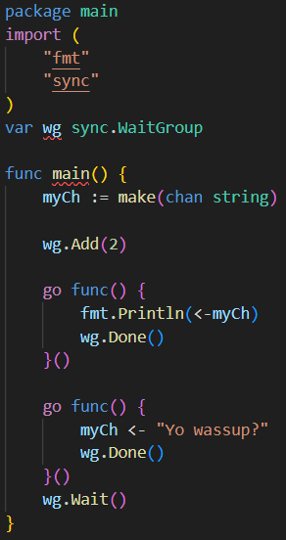

Example code for channels
Basic Syntax
output
A function used to receive data from a channel
A function used to send data to a channel
(Note that the order of calling the functions doesn’t matter cause we are using concurrency anyways)

Slide 13
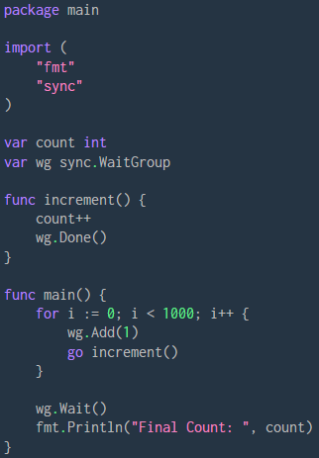
What do you think?
Let’s write a simple code which uses 1000 goroutines to add +1 in the “count” variable at the same time. Do you think that the value of count will be 1000 or something else?

Slide 14

The output?
Well, a few times the output was 1000 but most of the time the output was a little less than 1000. For example -

Slide 15
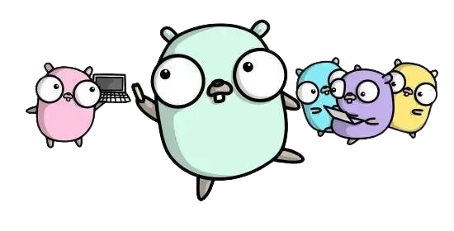

Bruh! Why?
This was because of “Race Condition”
A race condition happens when multiple goroutines (or processes) try to change shared data at the same time. This can lead to unexpected or incorrect behavior.
“Imagine two people writing on the same whiteboard at the same time. If both try to write different numbers, the final result depends on who finishes last, and the other person’s work might be lost.”

Slide 16
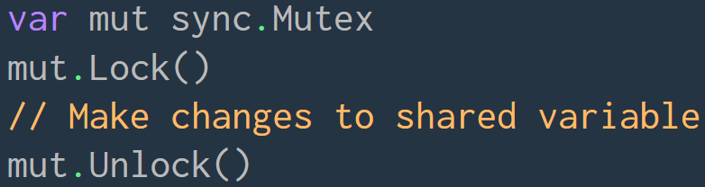

Mutex
Solution of “Race condition” is “Mutex”
A Mutex (short for Mutual Exclusion) is used to prevent multiple goroutines from accessing shared data at the same time, avoiding race conditions. Mutex does it by locking the shared resource, using it and then unlocking it.
Syntax?
Initializing the mutex pointer
Blocking other goroutines to make changes to the data
Unblocking other goroutines after making changes to the shared resource

Slide 17
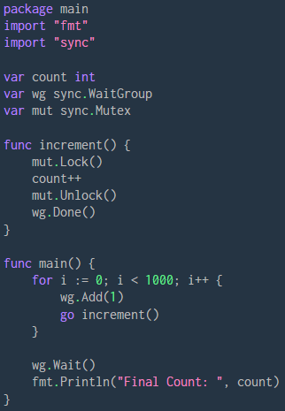

Using mutex!
Output was 1000 everytime!

Slide 18

Real life applications?
In real life, mutex is used in Banking Systems (Account Transactions), Logging in Web Servers, Online Ticket Booking Systems, Multiplayer Game Scoreboards and a lot more!

Slide 19


“
Congrats!
Now you can flex on your friends about that you know concurrency!
”

Slide 20


Thanks!
You rn:

